Slide 1
Capstone Project: Battle of the Cities
By Enas J Kazi

Slide 2
About
This is the final project on the course Applied Data Science Capstone. This course is a part of the 9 courses of IBM Data Science.
In this project, we’ll be using data science and its tools and methods to solve a business dilemma, where an entrepreneur seeks to find the best city in Finland to open a bookstore.
We’ll be discussing :
What data science is ? Where it can be applied?
Introduction to the business problem.
Data being used.
Methodology and analyze data.
Results obtained by analyzing the data.
Final conclusion

Slide 3

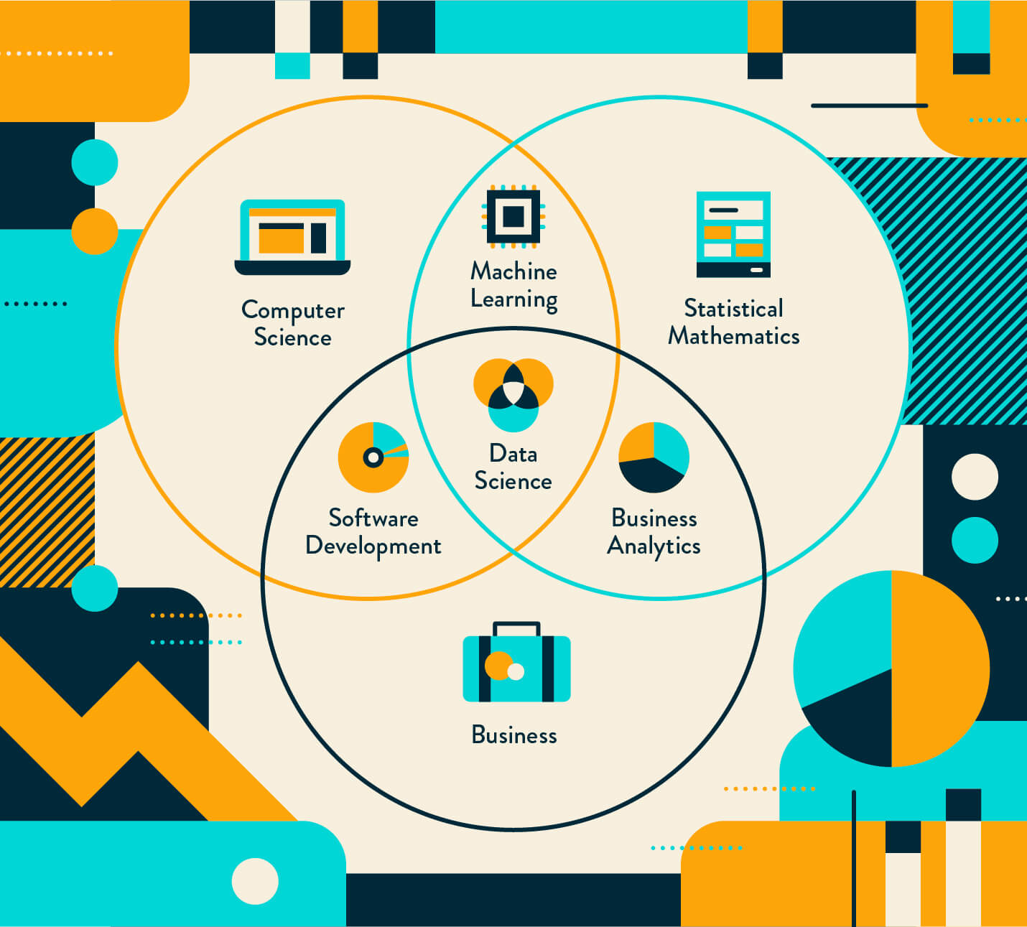
Data Science
Data science is an inter-disciplinary field that uses scientific methods, processes, algorithms and systems to extract knowledge and insights from many structural and unstructured data. Data science is related to data mining, machine learning and big data.
It is a "concept to unify statistics, data analysis and their related methods" in order to "understand and analyze actual phenomena" with data.
There are a variety of different technologies and techniques that are used for data science which depend on the application. More recently, full-featured, end-to-end platforms have been developed and heavily used for data science and machine learning.

Slide 4
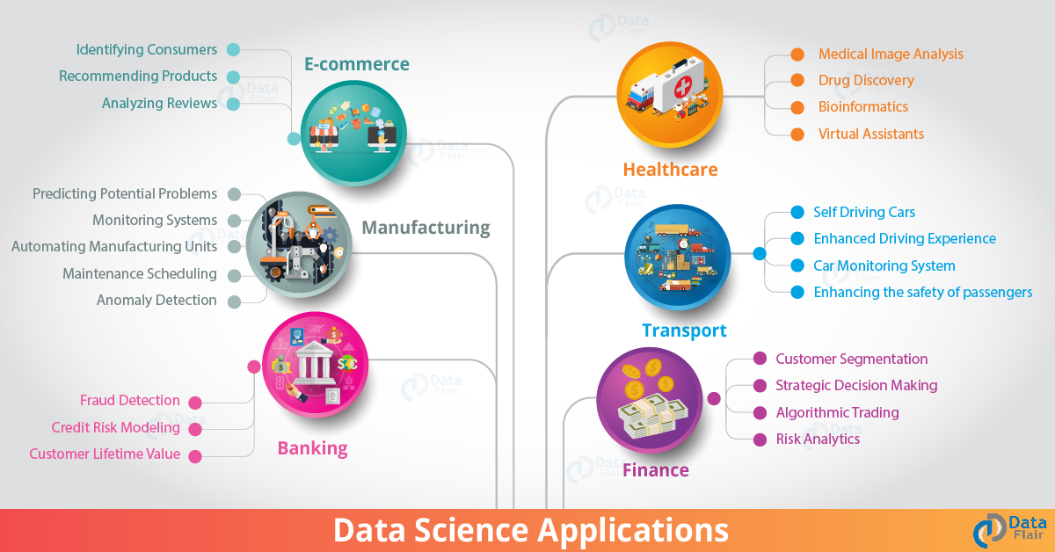
Some Data Science Applications

Slide 5
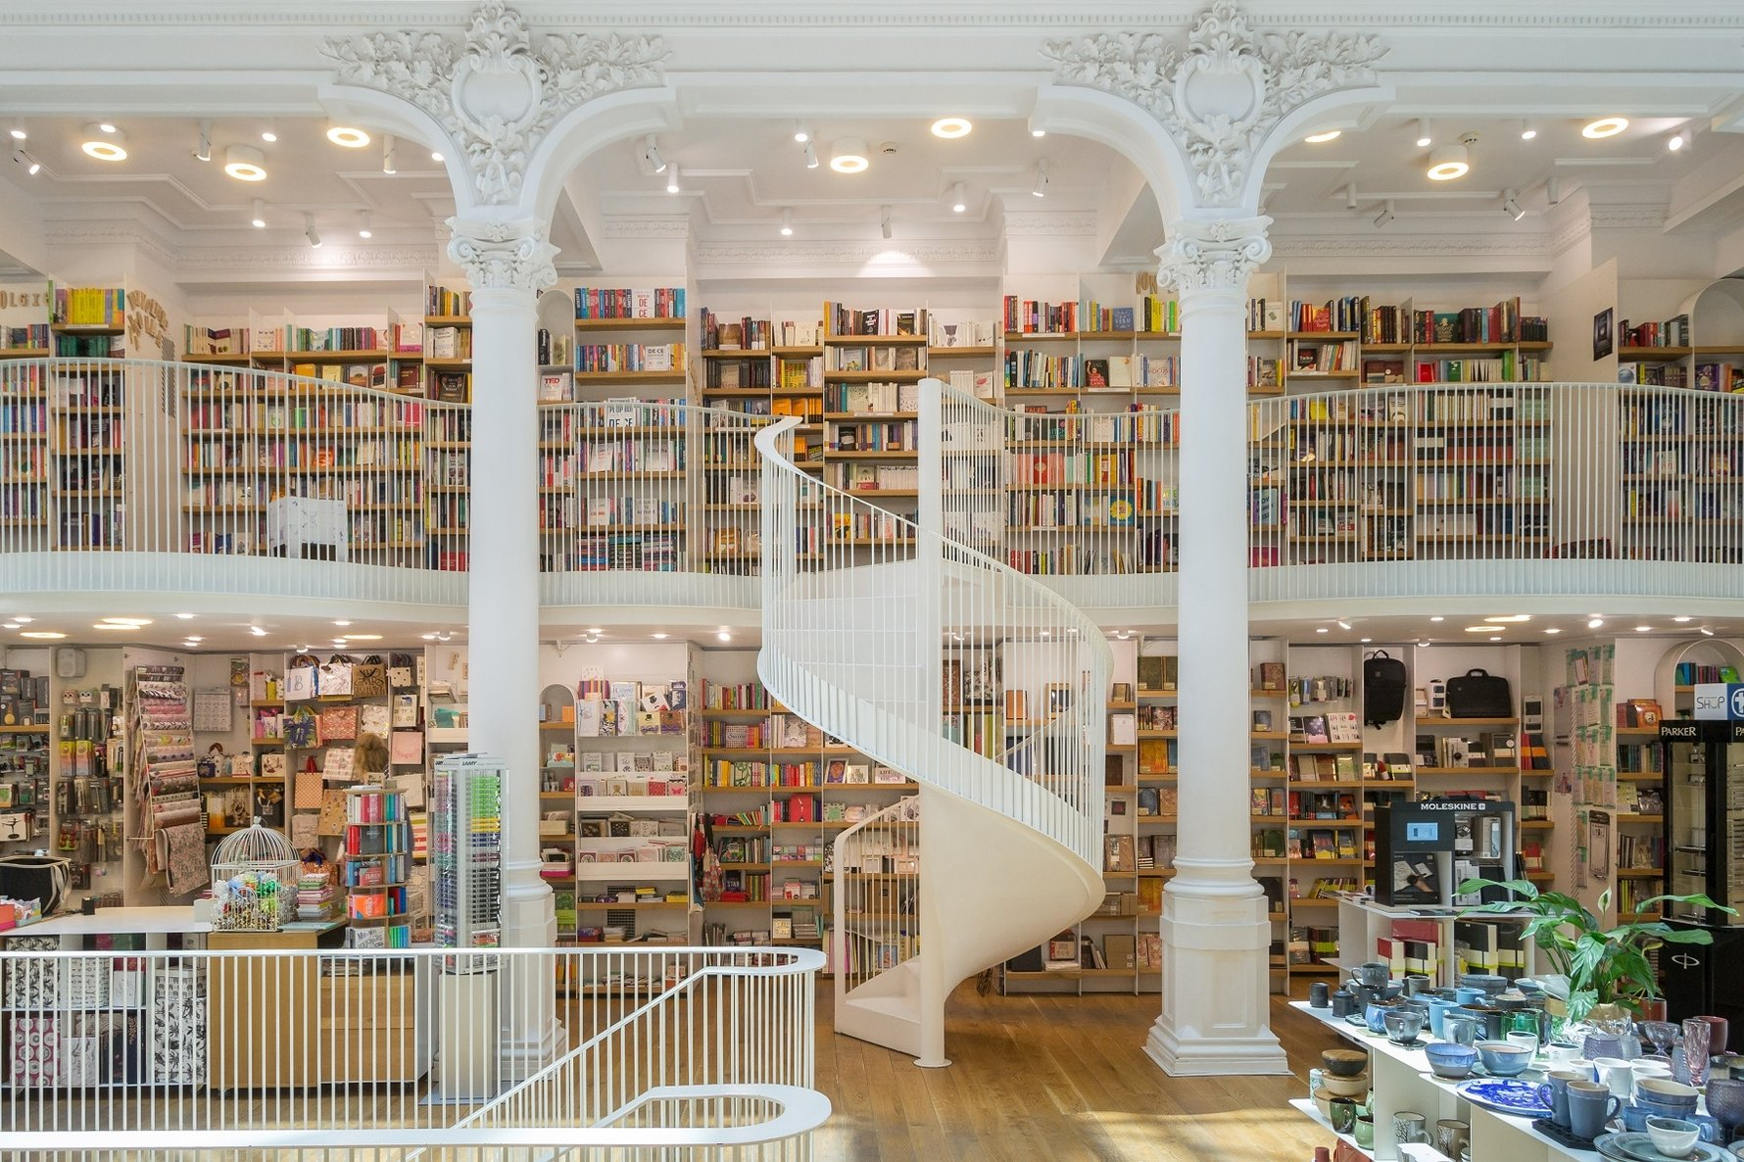
Introduction to the Business Dilemma
An enthusiastic entrepreneur wants to open up a bookstore in a populated city in Finland, with a in house café and kids corner. This project aims at finding an appropriate city to open a bookstore using data science and its tools. This project can be used by anyone who wishes to open a bookstore or any other retail business in Finland.

Slide 6
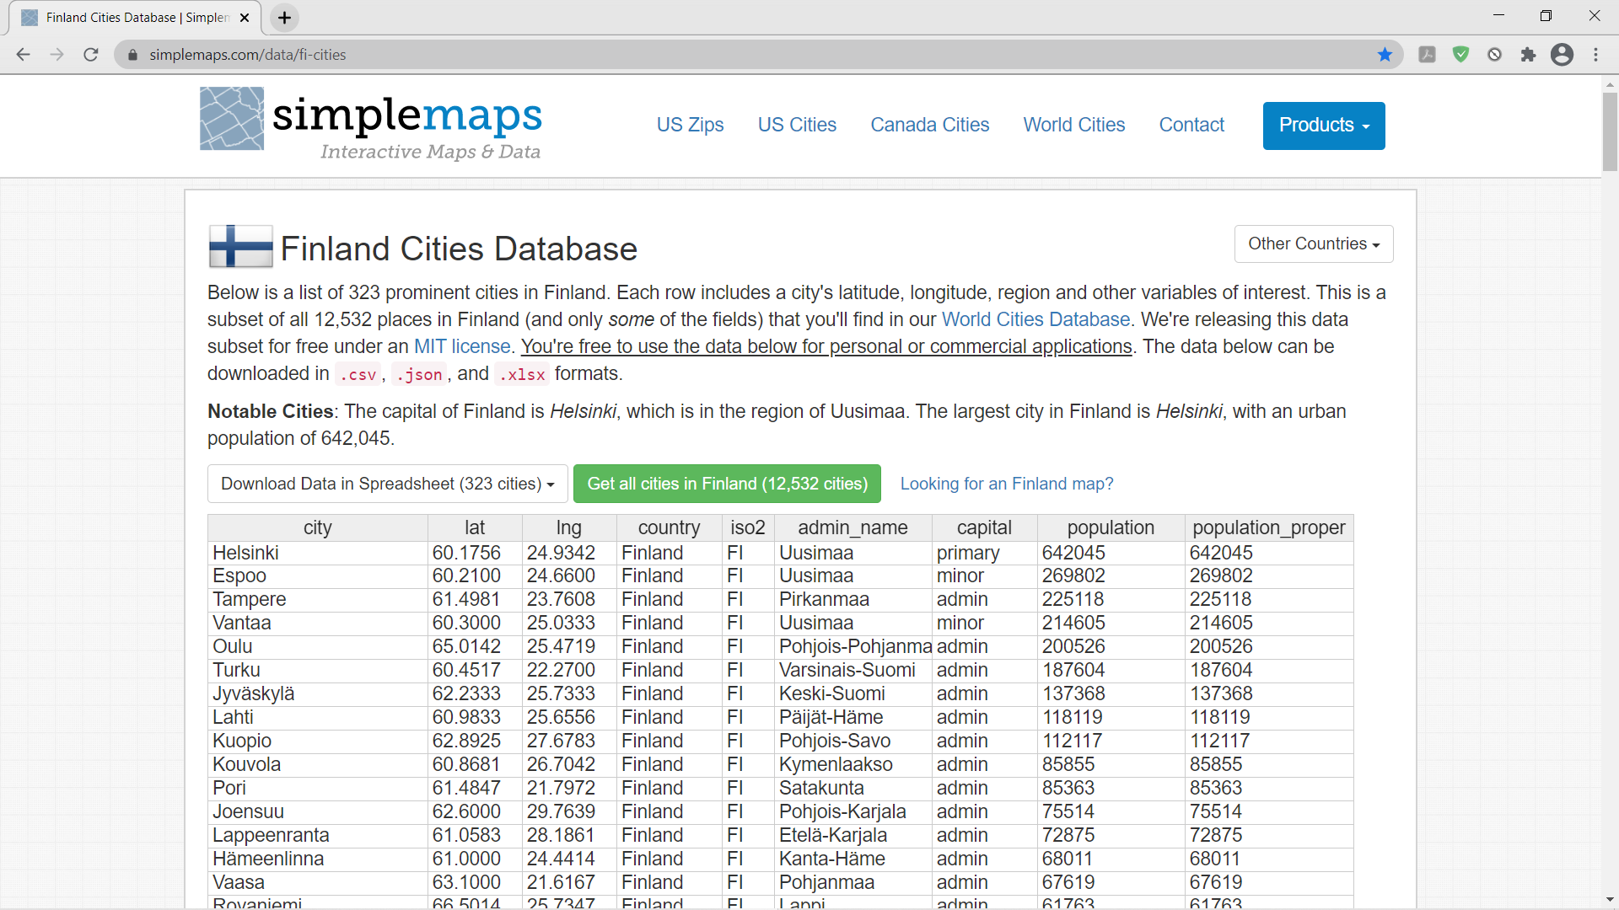
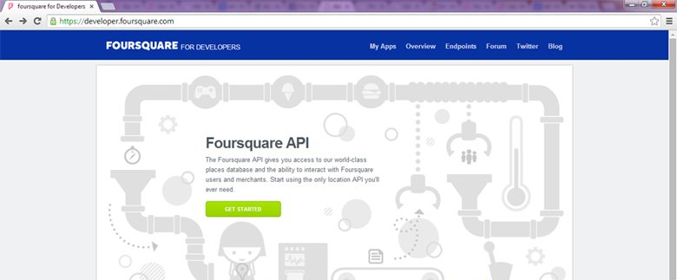
Data Used And its Source
The data needed for this project would be the name of the cities in Finland and their respective latitudes and longitudes, also the name, id , latitude and longitude of the respective venues in and around the cities of Finland.
Data for the city like the names, latitude and longitude of the city will be taken from the website: Simple maps, where the data is available in the form of a CSV file and
the name, id , latitude and longitude of the respective venues in and around the cities is provided by the Foursquare API.
Packages and libraries used are geopy, folium, geocoder, numpy, pandas, random, requests, matplotlib, Kmeans, JSON, Nominatim.

Slide 7
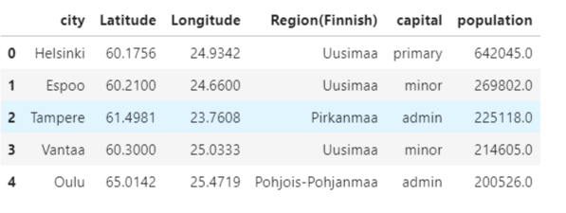
Methodology
Step 1: We use pandas to convert the CSV file containing the names of the cities and their latitude and longitude into a data frame.
Step 2: We clean the dataframe and pre-process it, by checking for any missing values, if so we drop these rows and also drop rows that have population less than 10000 as the owner wants a populated city. Once this is done are main dataframe for cities in Finland is ready .

Slide 8
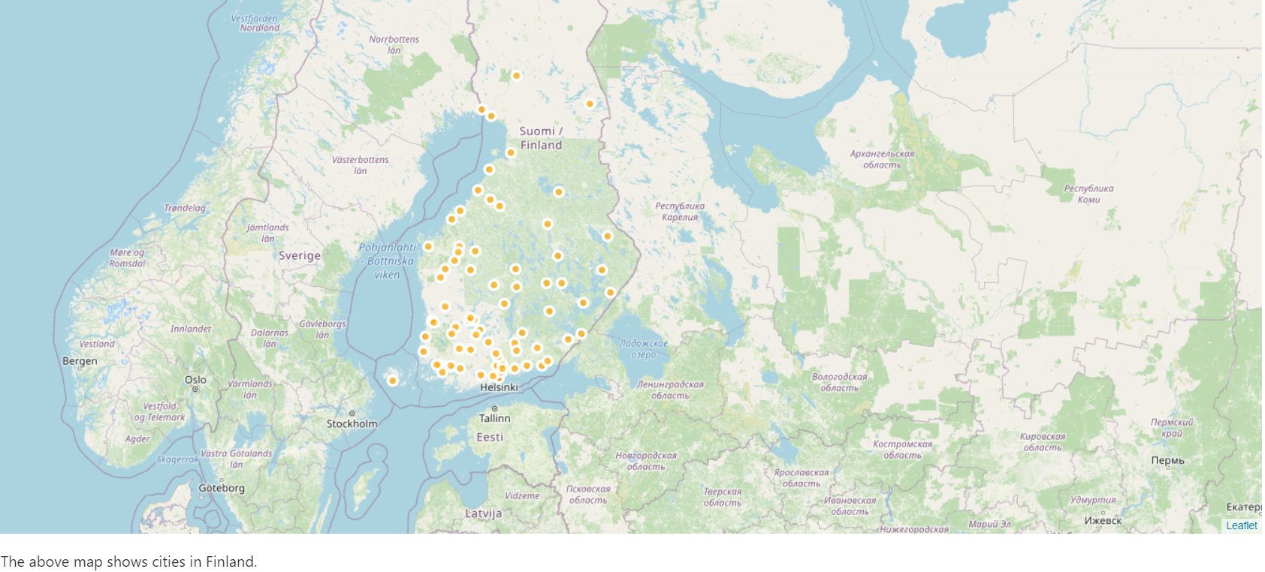
Step 3: For visualization, we plot the cities on an interactive map of Finland using Folium.

Slide 9
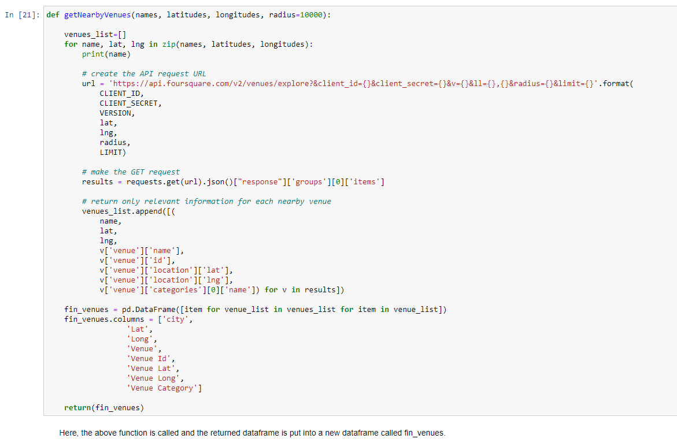
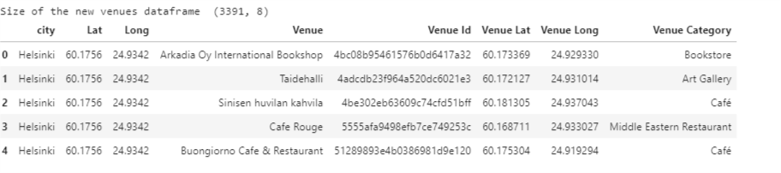
Step 4 : The Foursquare API is used to retrieve the data containing the venue names and their latitude and longitude locations. A function is created called getNearbyVenues to clean the data in JSON. This function extracts only the relevant information and then converts it into a dataframe when called. This gives us our second dataframe , containing the venue names and their latitude and longitude locations.
fin_venues
getNearbyVenues function

Slide 10
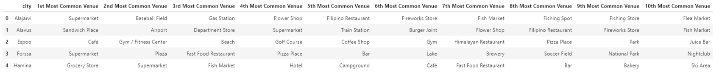
Step 5: Analyzing each city's venues. One hot encoding is used to group all the different venues according to their category for each city.
Step 6: A function called return_most_common_venues is created to sort the venues in descending order .
Step 7: Another dataframe called f_ venues is created that contains the top 10 most common venues for each city.
Step 8: Use of customer segmentation specifically, KMeans algorithm, to divide the data into 4 clusters and then finally create one last dataframe that contains all the data, the name of the city, the latitude and longitude of the city, the top 10 most common venues of that city and the cluster number that the city belongs to

Slide 11
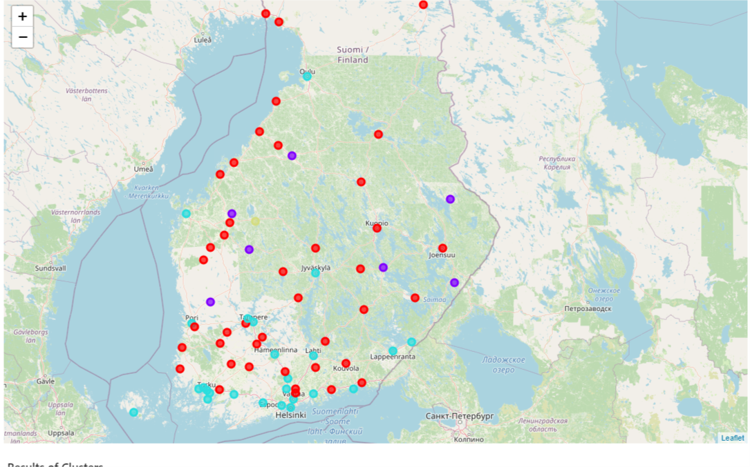
Step 9: For visualization, we plot the cluster onto the map of Finland. The different colours represent the different clusters.
Step 10: Print the different clusters groups separately.

Slide 12
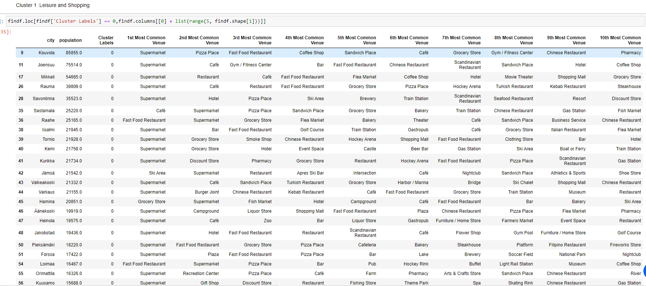
Results
After the analysis performed on the data of the cities and the venues in and around . We obtain the results in the form of clusters.
Cluster 1: Leisure and shopping

Slide 13
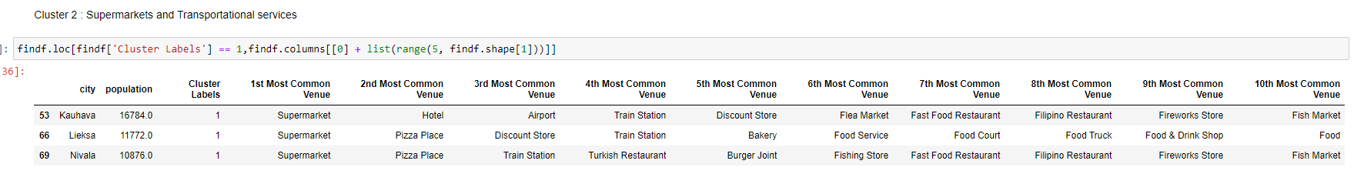
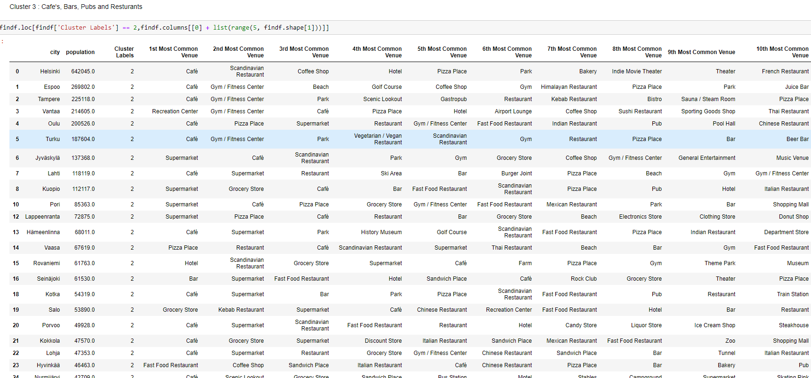
Cluster 2: Supermarkets and Transport services
Cluster 2: Café’s, Bars, Pubs and Restaurants

Slide 14
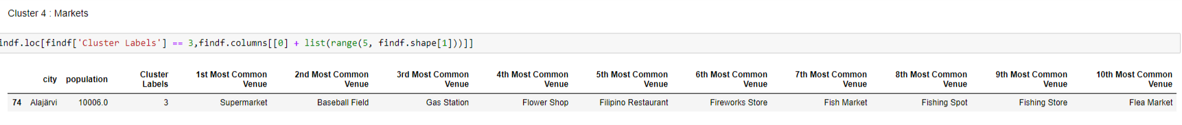
Cluster 4: Markets
From the above cluster group , we find that cluster 1 is more suitable.

Slide 15
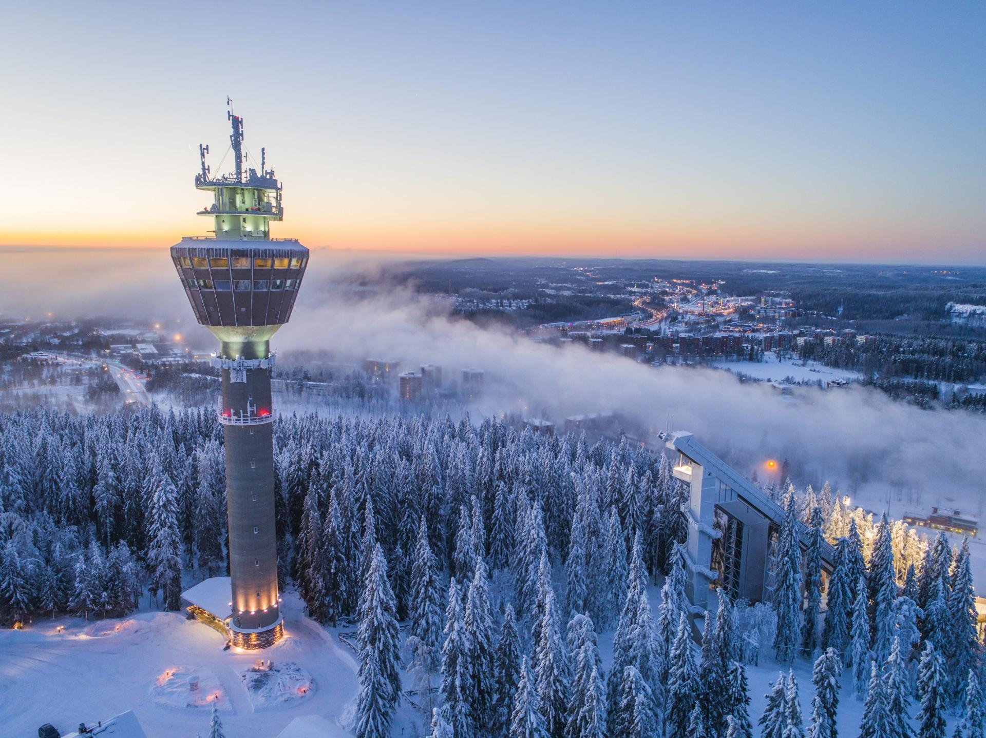
Conclusion
A conclusion can be drawn that cities in cluster 1 are more suitable to open up a bookstore. as the cities in cluster 1 are fairly populated and is advisable for the group of people that the owner plans on targeting. Hence, Cities in Cluster 1 are Suitable for opening a bookstore.
These cities are : Kuopio, Kouvola, Joensuu, Seinäjoki, Mikkeli, Kokkola, Järvenpää, Rauma, Kajaani, Savonlinna, Kerava, Nokia, Riihimäki, Sastamala, Raahe, Iisalmi, Tornio, Kemi, Kurikka, Jämsä, Valkeakoski, Hamina, Äänekoski, Heinola, Jakobstad, Pieksämäki, Forssa, Toijala, Loimaa, Orimattila, Kuusamo, Uusikaupunki, Lovisa, Ylivieska, Lapua, Kauhajoki, Ulvila, Kalajoki, Paimio, Huittinen, Keuruu.
This project shows how data science can be used to solve business problems.

Slide 16
Thank you

